Slide 1
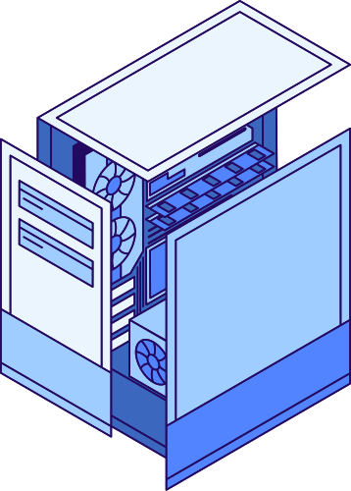


INTELLIGENT DOCUMENT SEARCH AND
QUESTION ANSWERING USING RAG
ASK QUESTIONS. RETRIEVE KNOWLEDGE. GET GROUNDED ANSWERS.
TECHNOLOGY STACK: PYTHON | STREAMLIT | LANGCHAIN | LANGGRAPH | FAISS | HUGGING FACE EMBEDDINGS | OLLAMA
PROJECT CATEGORY: GENERATIVE AI | RETRIEVAL-AUGMENTED GENERATION | INTELLIGENT DOCUMENT PROCESSING

Slide 2
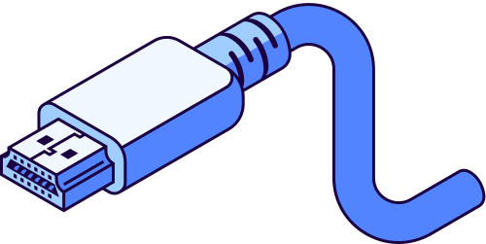

BUSINESS PROBLEM & OBJECTIVE
Business Problem
Project Objective
  Business knowledge is often distributed across lengthy documents.
  Finding specific information manually consumes time.
  Traditional keyword search may miss contextually relevant information.
  Repeated questions create unnecessary effort for employees and support teams.
  Build an AI-powered assistant that retrieves relevant information from uploaded documents and generates context-aware answers in natural language.
  Business value: Simplify information access and reduce manual document searching.
www.reallygreatisite.com

Slide 3


PROPOSED SOLUTION
Enterprise AI Knowledge Assistant
The application allows users to upload PDF documents and ask questions in natural language.
How it works:
  Upload a PDF document.
  Extract and split the document into smaller chunks.
  Convert chunks into embeddings.
  Store embeddings in a FAISS vector index.
  Retrieve relevant chunks for a user's question.
  Evaluate retrieved content and generate an answer using an LLM.
Outcome: Answers are generated using retrieved document context rather than relying solely on the LLM's general knowledge.

Slide 4
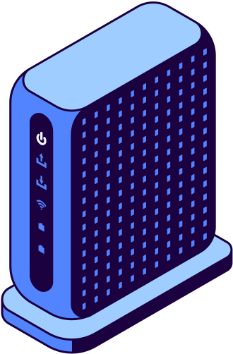

SOLUTION ARCHITECTURE
End-to-End Architecture
User → Streamlit UI → Document Processing → Embeddings → FAISS Vector Store → Retrieval → LangGraph Workflow → Ollama LLM → Answer
Component responsibilities:
  Streamlit: User interface for uploading documents and asking questions.
  LangChain: Document loading, text splitting, and retrieval components.
  Hugging Face Embeddings: Convert text into numerical representations.
  FAISS: Search for semantically similar document chunks.
  LangGraph: Organize retrieval, relevance evaluation, and answer-generation steps.
  Ollama: Run the selected language model locally.

Slide 5


RAG WORKFLOW
1. Ingestion
  Load PDF documents.
  Split text into manageable chunks.
  Generate embeddings and store them in FAISS.
2. Retrieval
  Convert the user's question into an embedding.
  Retrieve the most relevant document chunks.
3. Context Evaluation
  Evaluate whether retrieved content is relevant.
  Refine the context when required by the implemented workflow.
4. Generation
  Pass the question and relevant context to the LLM.
  Generate a natural-language response grounded in the retrieved information.
Key benefit: Improves access to document-specific knowledge without requiring the LLM to be fine-tuned on every document.

Slide 6
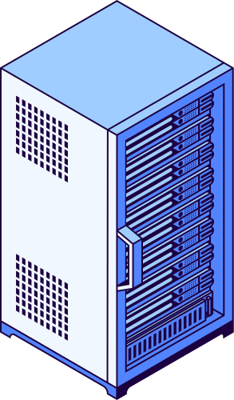

TECHNOLOGY STACK
Python
01.
Streamlit
02.
LangChain
03.
LangGraph
04.
Hugging Face Embeddings
05.
FAISS
06.
Ollama
07.

Slide 7

BUSINESS USE CASES
Potential Applications
1. Internal Knowledge Management
Find answers in employee handbooks, process documents, and internal guides.
2. Technical Documentation
Retrieve relevant explanations from product manuals and technical documents.
3. Customer Support
Help support teams locate information in product FAQs and support guides.
4. Learning and Training
Answer questions from course materials and learning documents.
Current project scope: PDF-based question answering.
Future scope: Multiple document formats, enterprise repositories, access controls, and source citations.

Slide 8
EVALUATION & SUCCESS METRICS
Retrieval Quality
  Precision@K: How many retrieved chunks are relevant?
  Recall@K: How much relevant information is retrieved?
  Mean Reciprocal Rank (MRR): How highly is the first
relevant result ranked?
System Performance
  Document processing time
  Retrieval latency
  End-to-end response time
  Application error rate
Answer Quality
  Factual correctness
  Relevance to the question
  Faithfulness to retrieved context
Business Outcomes
  Time required to find information
  User satisfaction
  Reduction in manual searching

Slide 9


LIMITATIONS, RISKS & CONSIDERATIONS
Current Limitations
Production Considerations
  The initial solution focuses on PDF documents.
  Poor-quality or scanned PDFs may require OCR.
  Irrelevant retrieval can lead to incomplete or
inaccurate answers.
  Response time depends on document size, retrieval settings, hardware, and the selected LLM.
  Local Ollama execution requires the model to be accessible where the application runs.
  Secure document storage and access controls
  Testing for hallucinations and retrieval failures
  Logging, monitoring, and error handling
  User-specific document permissions
  Privacy and data-retention policies

Slide 10

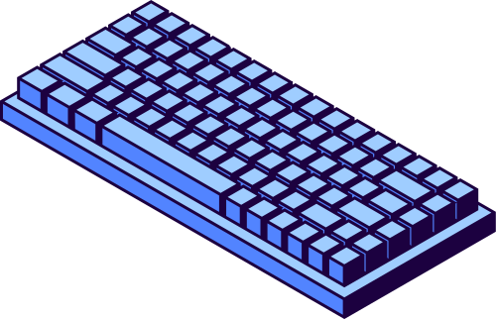
DEPLOYMENT & FUTURE ROADMAP
Current prototype:
  Streamlit application
  PDF ingestion and retrieval
  FAISS vector search
  LangGraph workflow
  Ollama-based answer generation
Future Roadmap:
  Improve retrieval quality through chunk-size tuning and reranking.
  Add document citations and support for additional file formats.
  Integrate enterprise knowledge sources.
  Introduce MCP-based tool integration and AI agents if required.
page 010

Slide 11
CONCLUSION
01.
Retrieves relevant information from uploaded PDFs.
02.
Uses embeddings and FAISS for semantic search.
03.
Uses LangGraph to organize the retrieval and response workflow.
04.
Uses an LLM to generate context-grounded answers.
05.
Provides an interactive interface through Streamlit.

Slide 12



